Slide 1

Digital Portfolio
STUDENT NAME: S.HARIHARAN
REGISTER NO AND NMID: 222402589 AND C320F7956061D6D9F184A17D52F57576
DEPARTMENT: COMPUTER SCIENCE WITH DATA SCIENCE
COLLEGE: COLLEGE/ UNIVERSITY PRINCE SHRI VENKATESHWARA ARTS AND SCIENCE COLLEGE.MADRAS UNIVERSITY
1
Notes:
1

Slide 2

PROJECT TITLE
GRADUATE PORTFOLIO WEBSITE
2

Slide 3



AGENDA
Problem Statement
Project Overview
End Users
Tools and Technologies
Portfolio design and Layout
Features and Functionality
Results and Screenshots
Conclusion
Github Link
3/21/2024 Annual Review
3

Slide 4

PROBLEM STATEMENT
Resumes in PDF or paper formats are static.They are difficult to update frequently with new skills.Sharing updated versions with recruiters becomes time-consuming.A digital portfolio allows instant updates and easy sharing.
4

Slide 5

PROJECT OVERVIEW
Interactive Skills PortfolioThe project focuses on showcasing my technical and analytical skills in Data Science. My skills are displayed with progress bars or charts, along with About Me, Education, Hobbies, and Contact sections supported by my profile image.
5

Slide 6

WHO ARE THE END USERS?
The end users of my digital portfolio are recruiters and hiring managers who can easily access my profile, skills, and achievements to evaluate me for internships or job opportunities.
6

Slide 7

TOOLS AND TECHNIQUES
HTML → For writing the content such as About Me, Education, Skills, and Hobbies.
CSS → For formatting text, setting background colors, and styling images.
Web Browser → To test and view the portfolio while developing.
GitHub → To upload and make the portfolio publicly available.
7

Slide 8
POTFOLIO DESIGN AND LAYOUT
Home → Profile image and welcome text at the top.
About Me → A paragraph in plain text.
Skills → Simple text list (example: Python, HTML, CSS).
Education → Written like a timeline (Year – Course – Institution).
Hobbies → Written as a short list.
Contact → Details written in separate lines (Name, Phone, Email)
.Responsive → Sections stack vertically for smaller devices.
8

Slide 9
FEATURES AND FUNCTIONALITY
Easy navigation – smooth movement between sections.Profile picture – makes the page more personal.Project details – explains my works clearly.Responsive view – adapts to screen sizes.Simple design – keeps focus on main content.

Slide 10
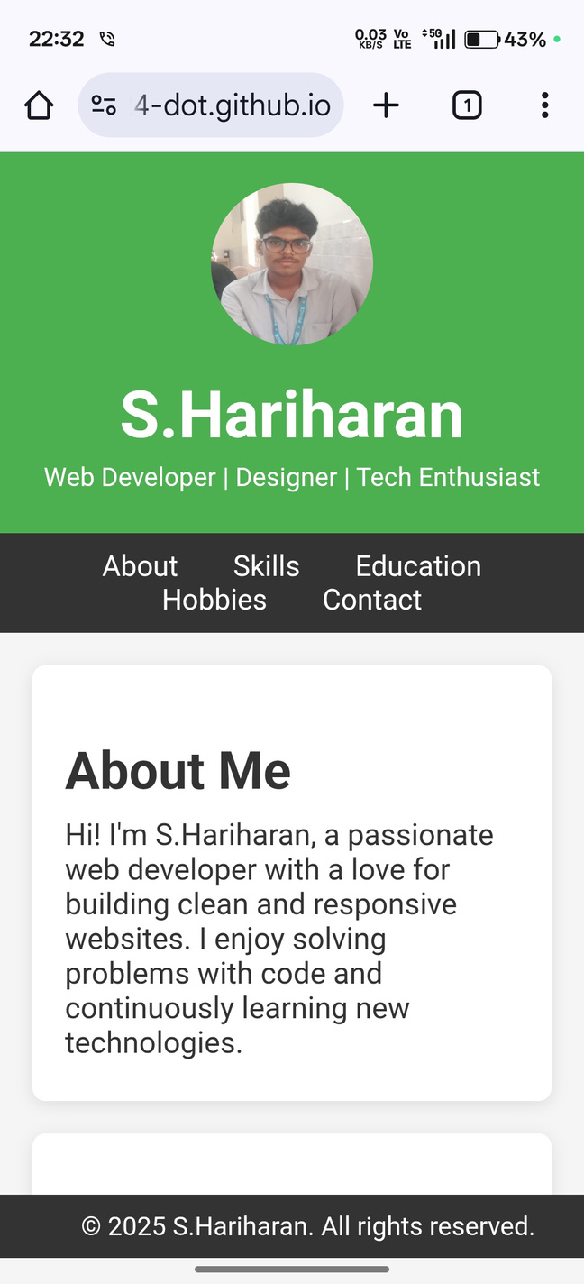
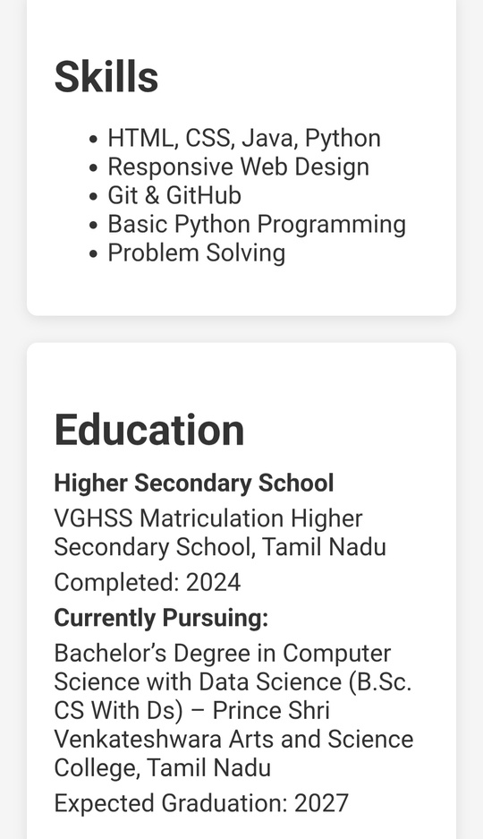

RESULTS AND SCREENSHOTS
3/21/2024 Annual Review
10

Slide 11
CONCLUSION
My portfolio is an online representation of me.It covers my About, Education, Skills, and Hobbies.The design is simple, clean, and readable.It can be accessed anytime through a browser.This project improved my basic web development knowledge.
11

